Slide 1

Quality Inspection Model
Lebanese University
Faculty of Engineering III, Hadath
Presented to: Dr. Mohammad awde
Prepared by: Ahmad Ismail-5476
hassan abbas- 5615

Slide 2
Table of Contents:
Introduction
What is Machine Learning?
Classification
K-Nearest-Neighbors
The Quality Inspection Model
Conclusion

Slide 3
Table of Contents:
Introduction
What is Machine Learning?
Classification
K-Nearest-Neighbors
The Quality Inspection Model
Conclusion

Slide 4
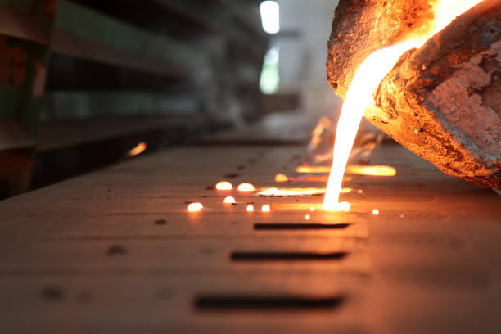
Introduction
Casting is a manufacturing process used by the forging industry to produce an object (often metal) of a specific desired shape.

Slide 5
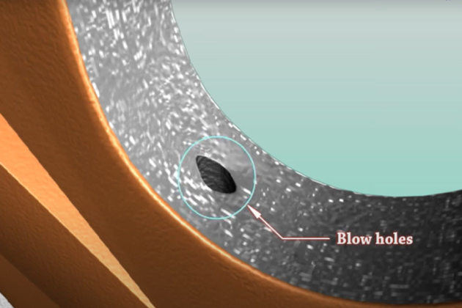
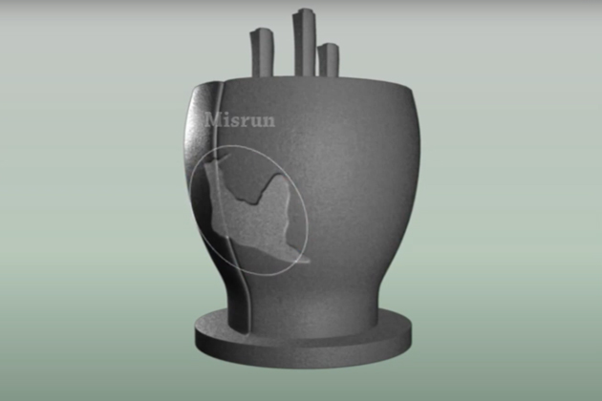
Introduction
Casting defect is an undesired irregularity in a metal casting process.

Slide 6
Introduction
Our goal behind this project is to present the quality inspection model in order to detect and classify if the product manufactured is defective or not.
The model proposed is based on machine learning and specifically on the KNN algorithm

Slide 7
Table of Contents:
Introduction
What is Machine Learning?
Classification
K-Nearest-Neighbors
The Quality Inspection Model
Conclusion

Slide 8
What is Machine Learning?
Machine learning is an application of artificial intelligence (AI)

Slide 9
What is Machine Learning?
The primary aim is to allow the computers learn automatically without human intervention

Slide 10
Table of Contents:
Introduction
What is Machine Learning?
Classification
K-Nearest-Neighbors
The Quality Inspection Model
Conclusion

Slide 11
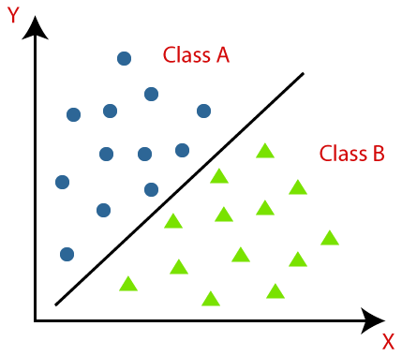
Classification
Classification predictive modeling is the task of approximating a mapping function (f) from input variables (X) to discrete output variables (y).
Classification belongs to the category of supervised learning where the targets also provided with the input data.

Slide 12
Table of Contents:
Introduction
What is Machine Learning?
Classification
K-Nearest-Neighbors
The Quality Inspection Model
Conclusion

Slide 13
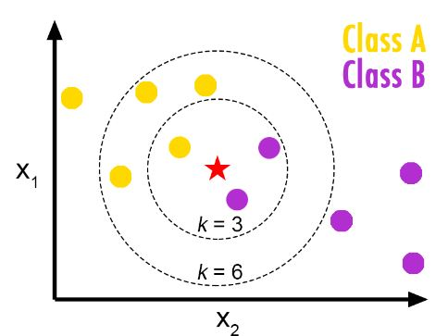
K-Nearest-Neighbors
The k-Nearest Neighbor classiﬁer is by far the simplest machine learning and image classiﬁcation algorithm.
This algorithm directly relies on the distance between feature vectors.
The k-NN algorithm classiﬁes unknown data points by ﬁnding the most common class among the k closest examples.

Slide 14
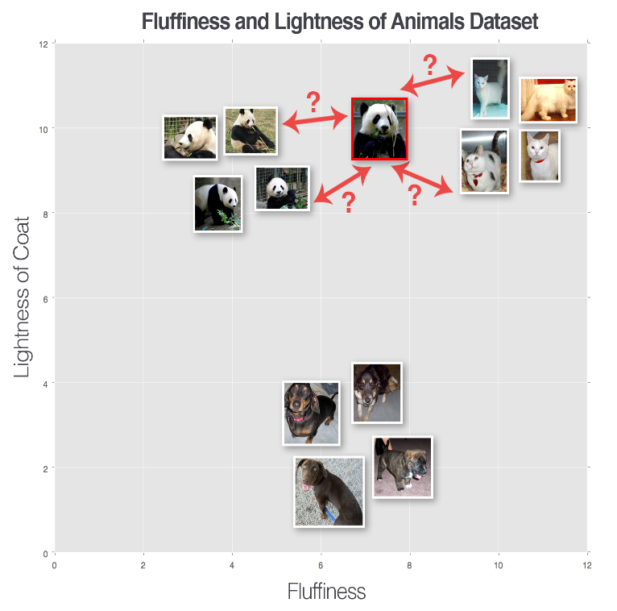
K-Nearest-Neighbors
Example:
We can see three categories of images, denoted as dogs, cats, and pandas, respectively.
In this pretend example we have plotted the "ﬂufﬁness" of the animal’s coat along the x axis and the "lightness" of the coat along the y-axis.

Slide 15
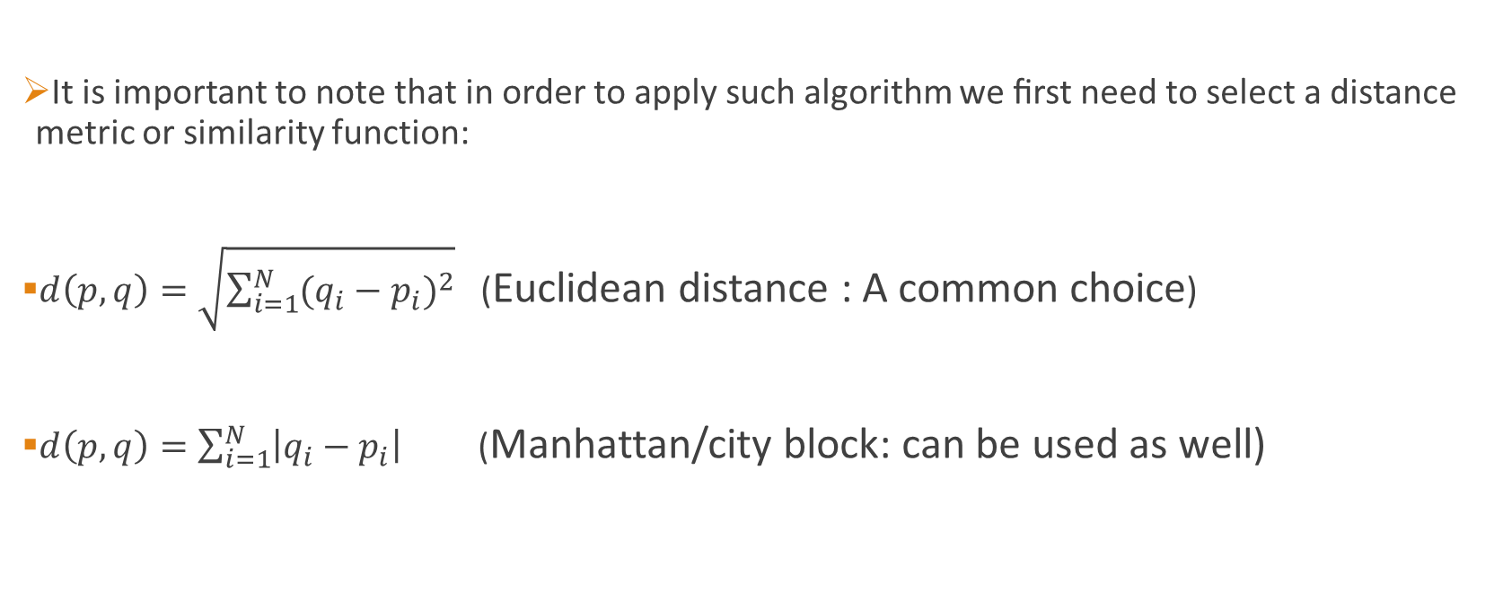
K-Nearest-Neighbors
It is important to note that in order to apply such algorithm we ﬁrst need to select a distance metric or similarity function:
$d\left(p,q\right)=\sqrt{\sum_{i=1}^{N}{{(q_{i}−p_{i})}^{2}}}$ (Euclidean distance : A common choice)
$d\left(p,q\right)=\sum_{i=1}^{N}{\left|q_{i}−p_{i}\right|}$ (Manhattan/city block: can be used as well)

Slide 16
Table of Contents:
Introduction
What is Machine Learning?
Classification
K-Nearest-Neighbors
The Quality Inspection Model
Conclusion

Slide 17
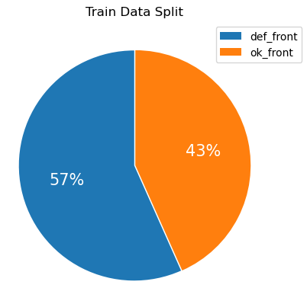
The Quality Inspection Model
This project was completely implemented in python.
The work flow of the model is very simple yet effective:
1-First we imported the necessary packages, like pandas, numpy, opencv, sklearn and other packages that helped us parsing files and displaying outputs.
2- Next we loaded our dataset and visualized its distribution:

Slide 18
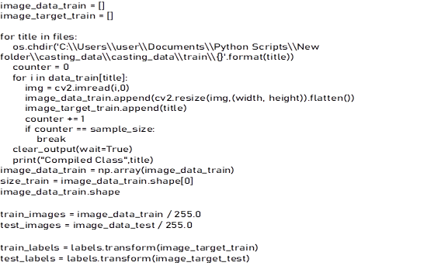
The Quality Inspection Model
3- After that we compiled the images in the dataset by resizing and converting them into numpy arrays, as follows(weight, height and sample_size were predefined):

Slide 19
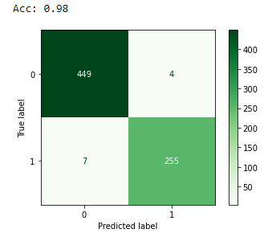
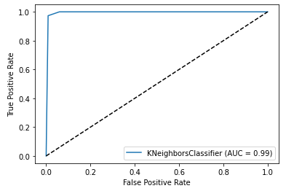
The Quality Inspection Model
The last step before prediction is to fit our data in the KNN model and calculate the final classification accuracy using our test dataset then plotting our results:

Slide 20
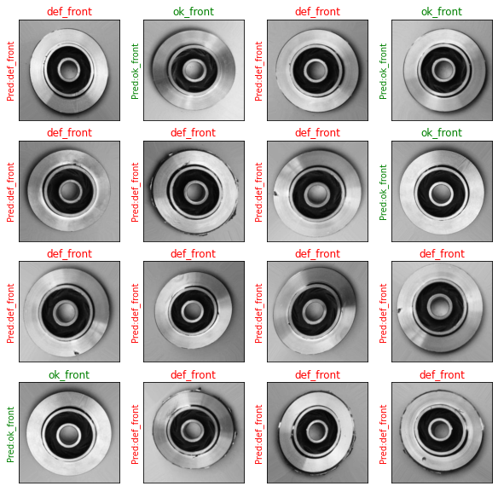
The Quality Inspection Model
Finally we test the classifier on randomly selected images, this gives pleasing results:

Slide 21
Table of Contents:
Introduction
What is Machine Learning?
Classification
K-Nearest-Neighbors
The Quality Inspection Model
Conclusion

Slide 22
Conclusion
Although the quality inspection model is simple and easy to implement, it still managed to provide us very good results.
Such model can be implemented in the forging industries and thus limit their use for a whole quality inspection department.
This model can detect defects that are sometimes hard for the human eye to notice.

Slide 23
Thank You For Your Time

